Slide 1
Cryptography
Overview

Slide 2
Cryptography
Cryptography is the use of mathematical algorithms and processes to transform intelligible plain text/data into cipher text, and vice versa.
It can be used for:
Confidentiality (Data Encryption)
Non-repudiation (Digital Signature)
Data integrity (Cryptographic Hashes and Digital Signatures)
Authentication for people, applications, and services (Digital Signature)
It can be used when:
Storing and Retrieving Data
Transmitting Data
Verifying Data Received
Gaining access to Data or Services (Access Control Systems)

Slide 3
Two Main Classes of Cryptography
Symmetric (Secret Key):
One key (the same) is shared for encryption and decryption.
Can quickly cipher large amounts of data
Problem of key agreement and distribution:
Two parties must share/exchange the secret key before using it
One key for each communication channel, so there is an exponential number of keys when large numbers of people are involved
Asymmetric (Public Key):
One key pair; two keys are mathematically bound between each other
If one is used to encrypt, only the other one can decrypt
One key is private, the other one is known publicly
Easier to distribute keys (just publish each entity's public key)
Problem of Asymmetric Cryptography:
Uses a lot of resources to encipher data and is slow

Slide 4
Secret (Symmetric) Key Cryptography
Based on simple functions, such as substitution and transposition :
Substitution: TEXT → 3$tP
Transposition: HELLO→ LOHEL
Block cipher systems normally executed in iterative/repetitive rounds
Stream cipher systems performed quickly in one pass
Very fast even with large files, and very secure with large keys.
Many algorithms available publicly which are designed for today’s high performance technologies
One single key is derived from a very large number space, which is then used for BOTH encryption and decryption
This single key MUST be known (shared/exchanged) between parties needing to use it.
There is no non-repudiation or proof that the key is safe

Slide 5
What can Alice do with a symmetric key?
Bob’s Copy of Key
Secret Key MUST be shared/exchanged
Alice’s copy of Key
With a
, Alice can…
PROTECT her files
Secret Key
With a
, Alice can…
ENCRYPT to Bob
Secret Key
After an exchange, with a
, Alice can…
DECRYPT from Bob
Secret Key

Slide 6
Public Key Cryptography
Based on one-way functions, such as discrete logs and factorization of large numbers:
Easy one-way: 4 ^ 9 → ?
Hard other way: x ^ y ← 262144
Much more complex with larger numbers, especially with prime numbers, for instance:
What two Prime Integers X ^ Y = 9.5453705 ^{E}61 ?
Key-pair is derived from a very large number ‘n’, which is the product of two prime numbers, X and Y, each of which may be 100 or more digits in length
Public Keys can be used for Confidentiality and to Verify digital signatures
The Private Key can be used to create digital signatures and to decrypt confidential messages
The same key (public or private) cannot be used to reverse the same operation performed (i.e., if the public key is used to encrypt, it cannot be used to decrypt)

Slide 7
What can Alice do with assymetric keys?
Bob’s Private Key
Bob’s Public Key
Alice’s Public Key
Alice’s Private Key
With
, Alice can…
SIGN messages
Alice’s Private Key
With
, Alice can…
PROTECT her files
Alice’s Public Key
With
, Alice can…
ENCRYPT to BOB, or
VALIDATE Bob’s messages
Bob’s Public Key

Slide 8
Asymmetric – Data Signing for Authentication
1
Alice writes a message to Bob
2
Message is signed with Alice’s Private Key, then sent over Network
Important Order
ATN: Private Group
Important Order
ATN: Private Group
DFX90687
3
Bob validates Alice’s message with Alice’s Public Key.
Important Order
ATN: Private Group DFX90687

Slide 9
Asymmetric - Data Encryption for Confidentiality
1
Alice writes a message to Bob
2
Message is encrypted with Bob’s Public Key, then sent over Network
Important Contract
ATN: Private Group
2AE9XFP49FOAC! E$AC9485DdAsDFFzFF09XPPSDQeR945$RE
3
Message is decrypted with Bob’s Private Key
2AE9XFP49FOAC! E$AC9485DdAsDFFzFF09XPPSDQeR945$RE
Important Contract
ATN: Private Group

Slide 10

Cryptographic Hash Functions
Hash functions are used to identify in a unique way any input
Hash inputs can be of any length
Hash outputs have a fixed length (depending on the Hash algorithm)
Hash functions are typically one-way
Two different hash inputs should not generate the same output (collision)
Input | MD5 Hash (128-bit outptut) | SHA-1 Hash (160-bit output)
World Clocks are Nice | d41d8cd98f00b204e9800998ecf8427e | 4c2731850527f7ba97e0c31026bdbbecd8801545
World Clocks Are Nice | 3b7a7b4bb91ce3a25adab34a9d2533a4 | F60f3155885566bd2c5b54069f6dc018a6406710
5 | e4da3b7fbbce2345d7772b0674a318d5 | Ac3478d69a3c81fa62e60f5c3696165a4e5e6ac4
MyPassword9$ | F696d1859228db7f8f54743f649d9810 | B7b98b3c68696c316dd69a0942c2246a2d0b01a5
contract.ppt 7,234 KB | 95b3554a88160fed8834214fff502ff1 | 6a47fd3c7a05bc9ef89b82bb6b41ea51e0498f0e

Slide 11
Cryptographic Hash Function (Digest)
1
Alice writes a message to Bob
2
Message is input to Hash Function, Digest is appended to message, then sent to Bob
Important Order
ATN: Private Group
Important Order
ATN: Private Group
3
Bob generates a new digest on the original message; the two digests MUST then match.
Hash(A)
DF90CB2
Important Order
ATN: Private Group
Hash(B)
DF90CB2
DF90CB2

Slide 12
PKI – Digital Signature for non-repudiation - Sending
Important Order
ATN: Private Group
Important Order
ATN: Private Group
Important Order
ATN: Private Group
Hash(A)
Hash(A)
E3098FF0
1
Alice writes a message to Bob
2
Hash of message is created
3
Hash is encrypted with Alice’s Private Key
Important Order
ATN: Private Group
5
Message is sent to Bob
E3098FF0
4
Alice’s Certificate is appended to message

Slide 13
Example of a Digital Signature
-----BEGIN PGP SIGNATURE-----
Version: PGP Universal 3.2.0 (Build 1950)
Charset: us-ascii
wsBVAwUBTyCP/Z/JsGz86uwqAQjkVAf/SGRuYcyncMiKGF6yAKWKNKJ9lMMC7tFA
UtASPx4fuD446XzdP4o0YVA9SE1f6WovpE4bPFLITw7mKU6I2UDGCGV48Qs24S2S
JXCv9H0csR8id40ZxVNN2sbLXWbjhTqnPy3Ng7ZQTejJeOw1ZChzkvsZTLou11gh
UauTH4VSl0yKAHDYQrN1HXF9W6O0GVexpvBhWRNFLL/1f0hmeSkxpWFQGx/3JUoa
vGCpT2FPnvhQc+DTvkIk5KSyZanz7qHcSf8PoiJXhfzZjtQr8getcMounZ2F+Ohh
8cLLQAhrcpbjlmCrfOUxqntuQEltFt5EYNKBEaBzMIWyt4YpiroXPQ===Y8tG
-----END PGP SIGNATURE-----

Slide 14
PKI – Digital Signature verification - Receiving
Important Order
ATN: Private Group
E3098FF0
1
2
3
Bob receives Alice’s message
CA’s Signature is verified
Alice’s Public Key is extracted
Important Order
ATN: Private Group
Hash(A)
=
E3098FF0
Hash(A)
Hash(B)
Hash(B)
4
Encrypted Hash is decrypted
5
New Hash is created from Alice Message
6
Both Hashes match

Slide 15
PKI for symmetric key exchange – Encrypting to Send
Important Contract
ATN: Private Group
Important Contract
ATN: Private Group
2AE9XFP49FOAC! E$AC9485DdAsDFFzFF09XPPSDQeR945$RE
2AE9XFP49FOAC! E$
1
2
3
Alice writes a message to Bob
Message is encrypted with Session Key (symmetric key)
Session key is encrypted with Bob’s Public Key
2AE9XFP49FOAC! E$AC948«««««5DdAsDFFzFF09XPPSDQeR945$RE
5
Message is sent to Bob
2A«E9XFP49FOAC! E$
4
Encrypted Session Key is appended to message

Slide 16
Receiving and decrypting messages using PKI
2AE9XFP49FOAC! E$AC948«««««5DdAsDFFzFF09XPPSDQeR945$RE
2A«E9XFP49FOAC! E$
2AE9XFP49FOAC! E$AC948«««««5DdAsDFFzFF09XPPSDQeR945$RE
Important Contract
ATN: Private Group
2A«E9XFP49FOAC! E$
1
Bob receives Alice’s message
2
Encrypted Session Key is decrypted with Bob’s Private Key
3
Session Key is used to decrypt Message

Slide 17
Public Key Infrastructure (PKI)
We have seen Public and Private Key Cryptography.
Why do we need an Infrastructure for it?

Slide 18
Concept of a Digital Certificate
A certificate associates in a SECURE way:
A public key
An owner (who must own the private key of the key-set)
A period of validity
A defined key usage (signature only, encryption, both, etc.)
Other optional elements
The certificate is signed by a TRUSTED authority and any change brought to the certificate after the signature of the authority would become evident once the signature is verified.
This key belongs to
Alice
Valid until 2012
Intended for digital signature
alice@Business.com
Notes:
The signature of the certificate is a proof of integrity of information contained in the certificate because it contains the hash of the message
NB: IF a local authentication, no need to use universal certificate (like verisign) but just a local trust certificate

Slide 19
Main PKI Components
Certification Authority (CA)
Registration Authority (RA)
Certificate Repository
Certificate Revocation Point
Certificate Authority
Registration Authority
Certificate Repository
Certificate Revocation Point
CRL
i.e. Verisign, Entrust, Microsoft, Baltimore, Novell
i.e. X500, LDAP, Active Directory, Web Servers, NDS
i.e. LDAP, FTP, HTTP, OCSP

Slide 20
Hierarchy of Certification Authorities
A
Root CA
B
C
D
Zero or more levels of Intermediate CAs
E
F
G
H
Non-CA End-Entities

Slide 21
Certificate Revocation
When revoked, a certificate is no longer valid – even if the initial expiration date has not been reached yet.
Revocation Delay:
Time between knowledge that certificate is revoked and actual posting of revocation information.
Two types of Revocation Mechanisms:
Periodic Publication Mechanisms:
Certificate Revocation List (CRL)
On-Line Query Mechanisms
Online Certificate Status Protocol (OCSP)

Slide 22
Other PKI Components
PKI vendors can offer different services:
Key Backup and Recovery
Automatic Key Update
Certificate Renewal
Key History
Time Stamping
Client Software
Others…

Slide 23
Type of Certificates
Currently Used: X.509 v3
Information about X.509 v3:
Internet Engineering Task Force (IETF)
Public Key Infrastructure X.509 (PKIX) Working Group
RFC2459
Other types of certificates:
Older versions of X.509 Public-key certificates:
Version 1
Version 2
Simple Public Key Infrastructure (SPKI) certificates
Pretty Good Privacy (PGP) certificates
Attribute Certificates

Slide 24
X.509 Version 3 Certificate Structure
Version
Version of Certificate
Serial Number
Unique Integer Identifier
Signature
Algorithm ID used to sign Cert
Issuer
Unique Name of Cert Issuer
Signed by Authorized CA (issuer)
Validity
Not before and not after
Subject
Unique Name of Owner
Subject Public Key Information
Public Key of the Owner
Issuer Unique ID
Optional Unique ID of CA
Subject Unique ID
Optional Unique ID of Subject
Extensions
Optional Extensions (eg. Key usage)

Slide 25
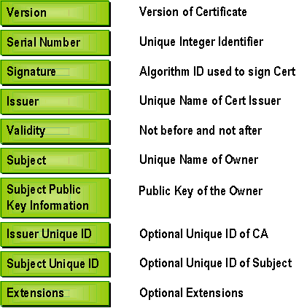
Certificate Signature Process
CA Signature
Hash(CA)
1
Hash is generated
2
Signed PKCS#10 Message
Signature Verification
Hash is signed With CA’s Private Key
User generates hash of the certificate
Hash(user)
?=?
Encrypted Hash(CA)
Encrypted Hash(CA)
3
Hash(CA)
Encrypted Hash (signature) is added to Certificate
Certificate
Decrypt with CA’s Public Key

Slide 26
Standards that rely on a PKI
Following standards assume, require or allow the use of a PKI:
Secure Web / Intranet
Secure E-Mail
Secure Socket Layer (SSL)
Transport Layer Security (TLS)
Secure Multipurpose Internet Mail Extensions (S/MIME)
Secure Network Access
Other Applications
VPN (IPSEC)
Secure Electronic Transactions (SET)
Europay MasterCard Visa (EMV) …

Slide 27
SSL Authentication
Web Browser
Web Server
1. Authentication
Anonymous
a. Server authenticates to client with PKI certificate
b. Client stays anonymous
SSL with Server Authentication Only
2. SSL Encryption
1. Authentication
Client and Server are using PKI certificates to authenticate to each other
SSL with Mutual Authentication (only available in SSLv3)
2. SSL Encryption

Slide 28
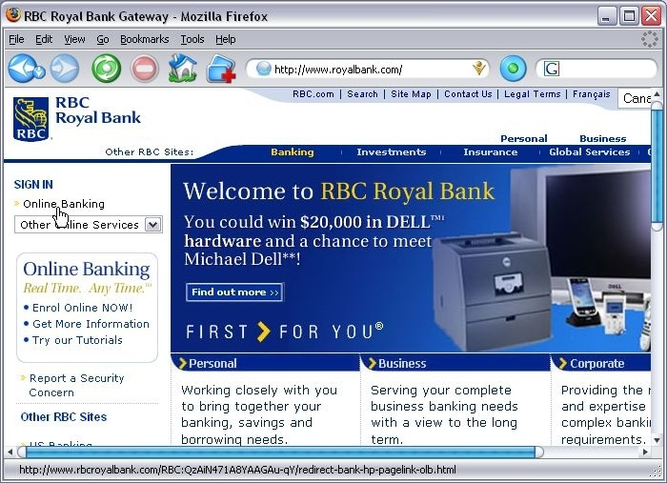
The SSL Process (The initial connection)
1
End-user clicks on « Online Banking » hyperlink

Slide 29
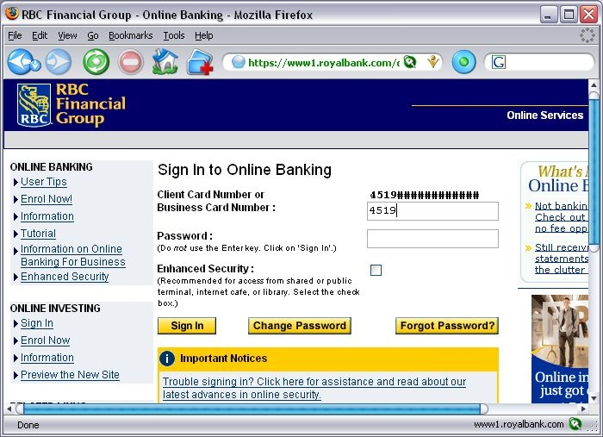
The SSL Process (The SSL Negotiation)
https: shows that SSL is now established
2
After an SSL establishment, user is taken into a secure page.
This icon represents the certificate that was used during the SSL handshake.

Slide 30
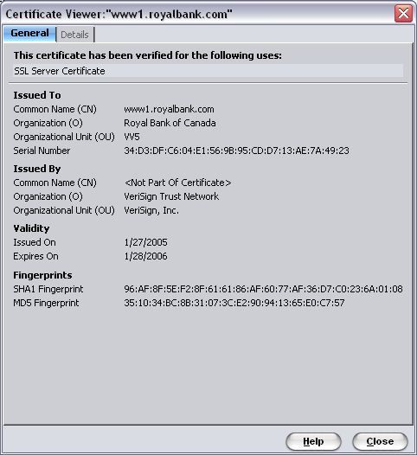
What PKI credentials were used by the bank?
Web Server presented a certificate which was issued by VeriSign Trust Network.

Slide 31
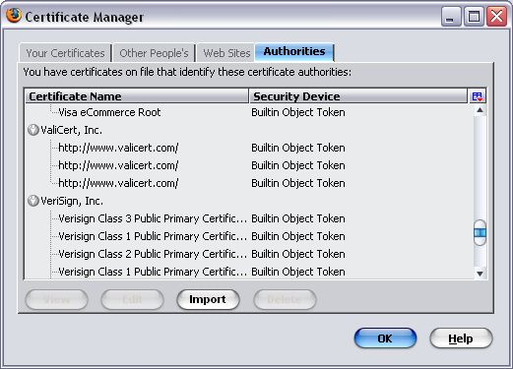
Why do you trust VeriSign?
Windows installs a series of trusted certificate authorities on your computer.
VeriSign is one of them.
Notes:
Explorer→ Internet Options → Content → Certificates → List of trusted CA’s
List all of trusted CA’s

Slide 32
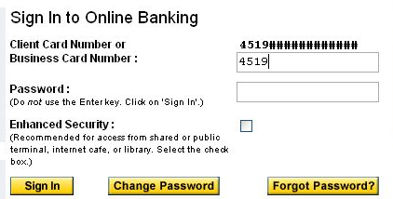
What happened in this SSL process?
At a glance:
The Web Server of the Royal Bank authenticated to your browser with PKI credentials
A session key was established: all communication are now encrypted and secure
You are still anonymous, so the web server of the bank now asks you to provide userid (Client Card Number + Password) and then proceeds to authenticate you as a bank client.

Slide 33

Understanding PKI Login
A PKI authentication (SSL, Windows, ActivID CMS) implies that you are able to prove that you own the private key associated with the public key of the certificate.

Slide 34
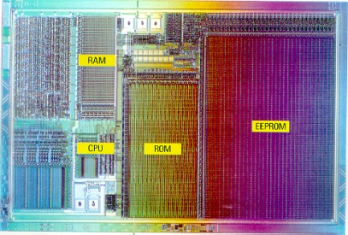
MiddleWare and Application Support for PKI Communication
Applications
PKCS#11
CAPI/CSP
…
High-Level Commands (PKCS#11, …)
PKCS#11
CAPI/CSP
…
MiddleWare (ActivIdentity)
APDUs (Card Specific)
Applications send high-level commands to middleware. Middleware translates requests into the card specific language: Application Protocol Data Unit (APDUs).
Smart Card Chip

Slide 35
What do you ask when authenticating a third-party with PKI?
Usually some data (including date and time) encrypted with the Private Key of the third-party
A valid certificate to verify the data
Data requested by client (encrypted with Private Key)
+
Controller
Third-party
Data may include current time, challenge, etc. It is encrypted with third-party’s Private Key
Valid third-party’s certificate which includes Public Key
Notes:
What happen exactly ?
Web server claim to be the right server
Browser request some information to be encrypted by the web server
Web servers provides datas (dates and time) encrypted with his private key, certificate and session key
Browser verify the certification and decrypt info using the public key
Communication is encrypted, you can logon

Slide 36
Key Generation
A generated key-set always includes a Public and a Private key
Keys can be generated by several CPUs in several locations:
By a Smart Card (very secure – keys cannot be escrowed)
By an Hardware Security Module (HSM) (very secure – keys can be escrowed)
By a Computer (unsecure – keys can be escrowed)
…
Key Generation is usually determined around key usage:
Signature and Non-repudiation: Smart Card
Encryption and Confidentiality: HSM

Slide 37
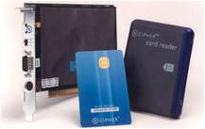
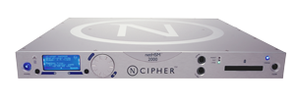
Hardware Security Module (HSM)
Role of an HSM:
Generate keys (RSA, 3DES, AES etc.)
Store cryptographic keys used to sign or encrypt
Encrypt/Decrypt data with its own crypto processor
Why use an HSM:
Very safe because an HSM has its own OS and crypto processor. Some operations (like key ceremonies or exchange) may require multiple administrators authenticated at the same time.
Type of HSM : Network HSM, PCI
Manufacturers : Thales (Ncipher), Safenet,….

Slide 38
Public Key Cryptography Standards (PKCS)
Set of standards protocols which enable secure information exchange through the use of public key infrastructure.
Microsoft offers an alternative to PKCS11: Crypto API (a.k.a. CAPI)
Vendors must provide a CSP interface to interract with CAPI.
PKCS#1 | RSA Cryptography Standard
PKCS#3 | Diffie-Hellman Key Agreement Standard
PKCS#6 | Extended-Certificate Syntax Standard
PKCS#7 | Cryptographic Message Syntax Standard
PKCS#8 | Private-Key Information Syntax Standard
PKCS#10 | Certification Request Syntax Standard
PKCS#11 | Cryptographic Token Interface Standard
PKCS#12 | Personal Information Exchange Syntax Standard
PKCS#15 | Cryptographic Token Information Format Standard

Slide 39
Some Common Algorithms
Name | Type | Minimum Key Length required to ensure security
RSA | Asymmetric | 1024-bit
Diffie-Hellman |  | 1024-bit
DES | Symmetric | 56-bit
3DES |  | 112-bit or 168-bit
AES |  | 128-bit , 192-bit, 256-bit
Name | Type | Output Size
SHA-1 | Hash function | 160-bit output
MD5 |  | 128-bit output
Some other algorithms: DSA, Twofish, Elliptic Curves (ECC), RC4/5/6, CAST, SAFER, SERPENT, SHA-256, SHA-512

Slide 40
DES Algorithm: example of symmetric cryptography
Data Encryption Standard
Clear Input
Encrypted Output
DES Encryption Algorithm
DES Decryption Algorithm
Single DES key
Encrypted Output
Clear Input
A DES key consists of 64
significant bits. 56 bits are the key used.
8 bits are for parity.
7
1
7
7
1
7
1
7
7
1
7
1
7
7
1
7
1
7
7
1
A DES key is 56-bits long. After every 7th-bit of key there is one bit of parity.

